Slide 1
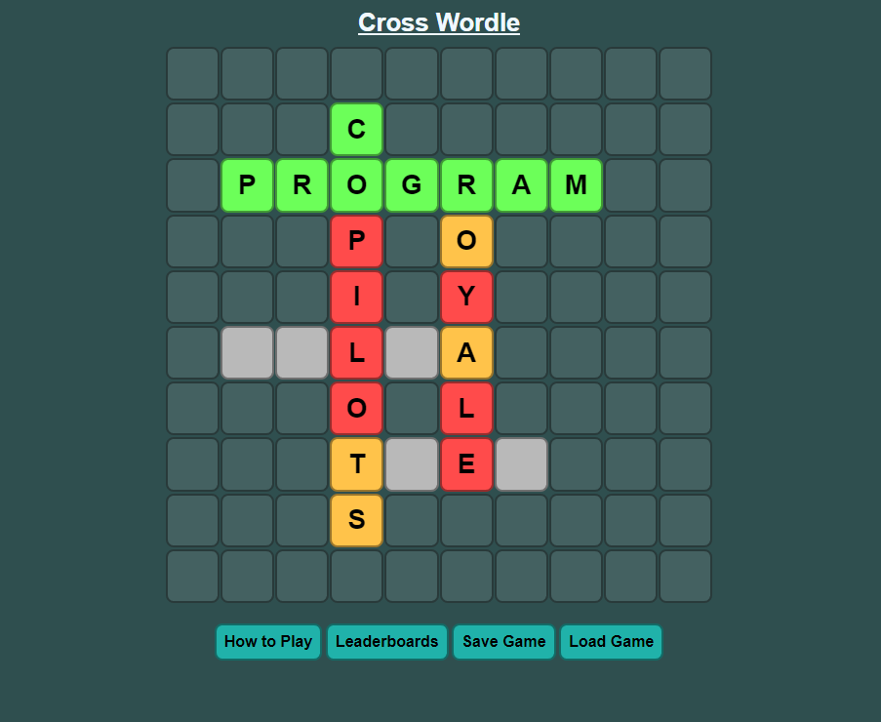
Cross Wordle
A Word Game by Matteo Salverio

Slide 2
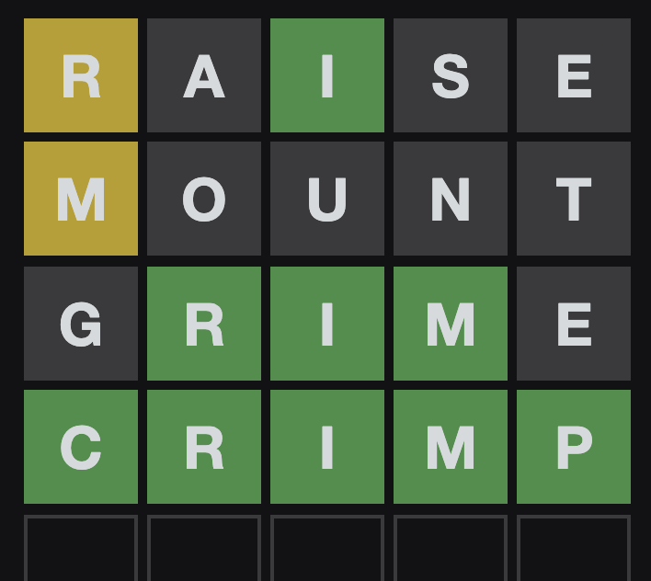
The Prompt
In 2022, Wordle and similar word games were all the rage across the world. Develop a word game with rules and a theme of your choice.
The game should be an executable game, either through the Internet or through a local installation (review guidelines about Internet access at the National Leadership Conference).
The game should contain a scoreboard.
The game should contain a leaderboard and celebratory messages.
The game should have a minimum of three levels.
The game should have an instructional display.

Slide 3
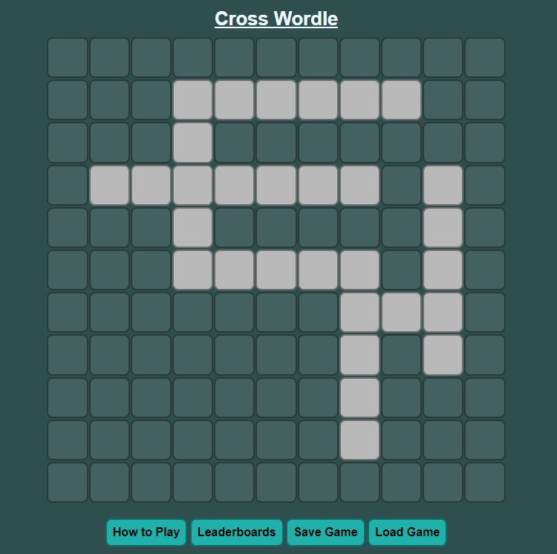
My Game
The game that I created is called Cross Wordle.
It is like Wordle but takes the gameplay to the second dimension with a full crossword-style puzzle connecting words and ideas, each being a puzzle of their own.

Slide 4

Programming Language
I chose to make this game using JavaScript on an HTML page.
It can utilize HTML design features.
Seamless communication between front and back-end.

Slide 5
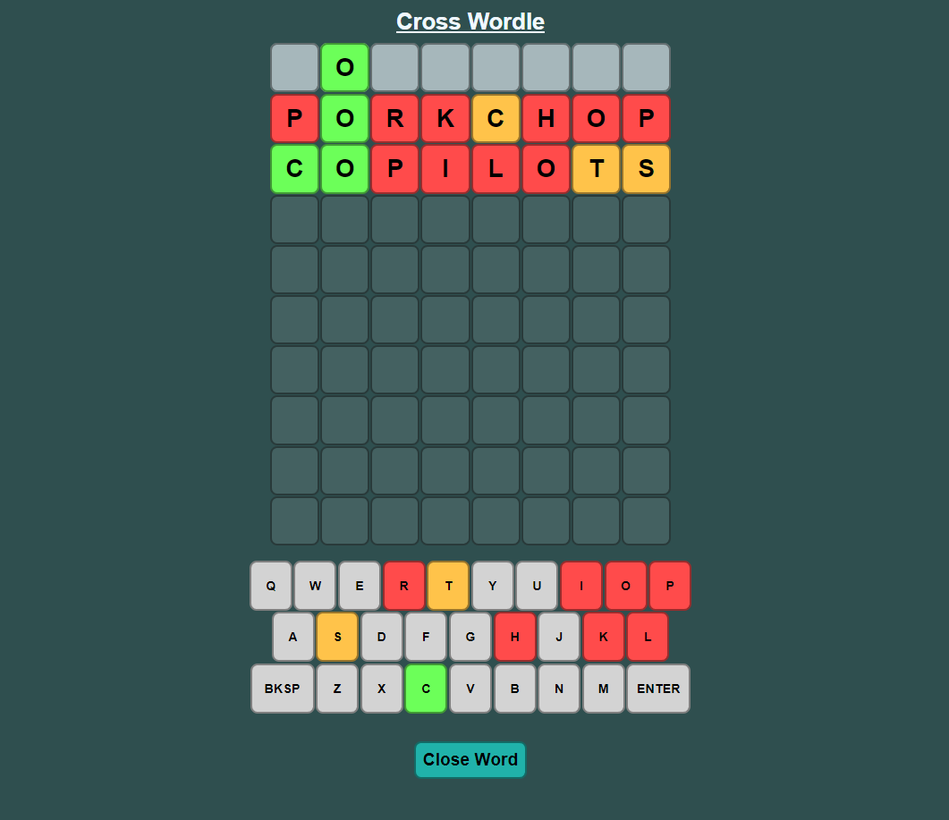
Gameplay Summary
The game is played mostly like a crossword puzzle.
Takes the simplicity of Wordle but adds some extra challenge to it.

Slide 6
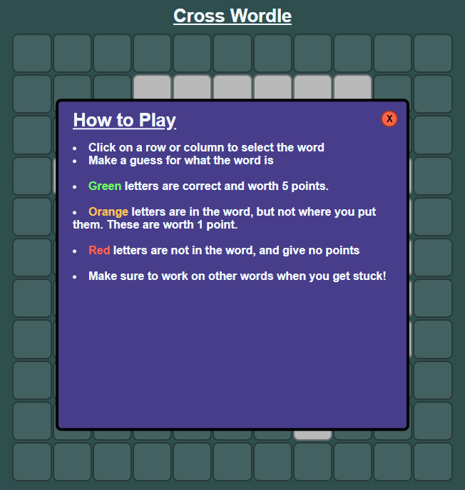
Getting Started
Upon opening the site for the first time, the player is greeted with a “How to Play” screen that gives a quick explanation of the game.

Slide 7
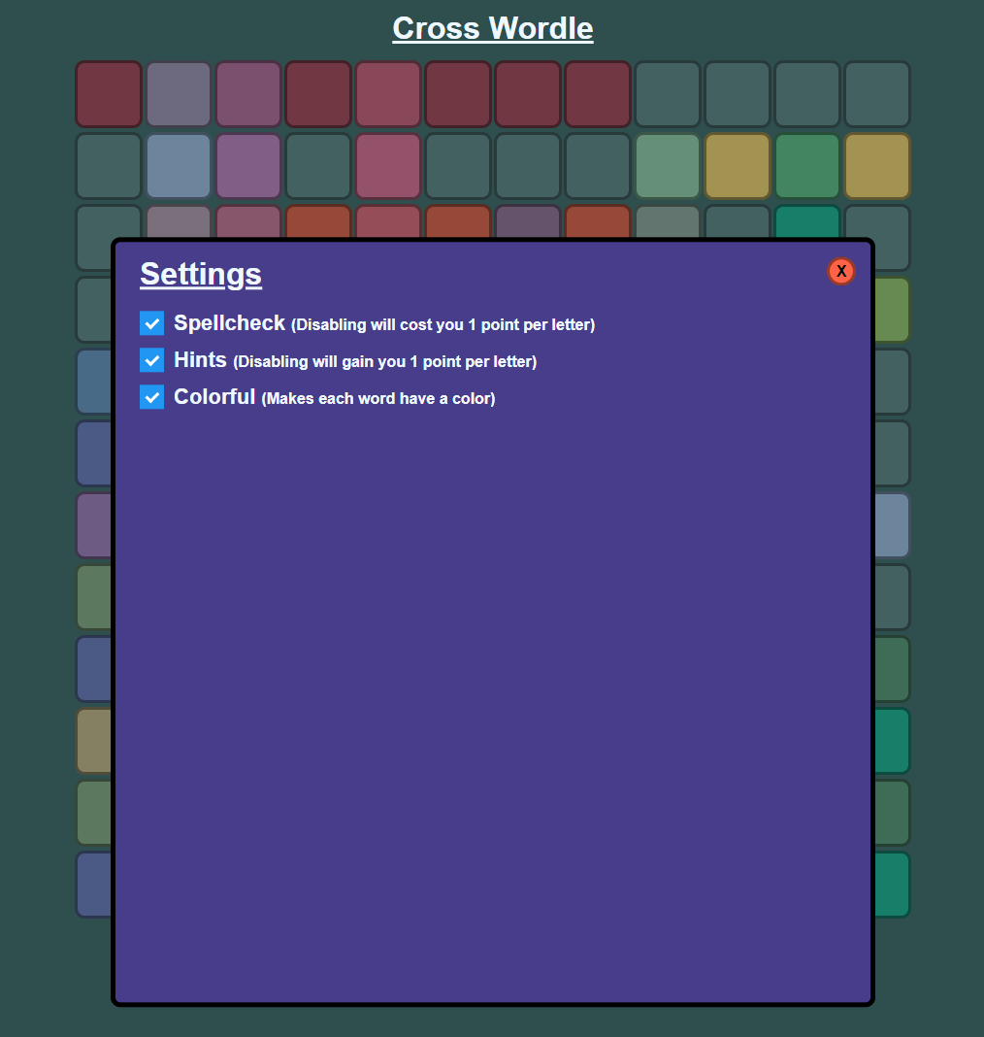
Settings Menu
A settings panel is provided.
Helpful features and options to improve experience.

Slide 8
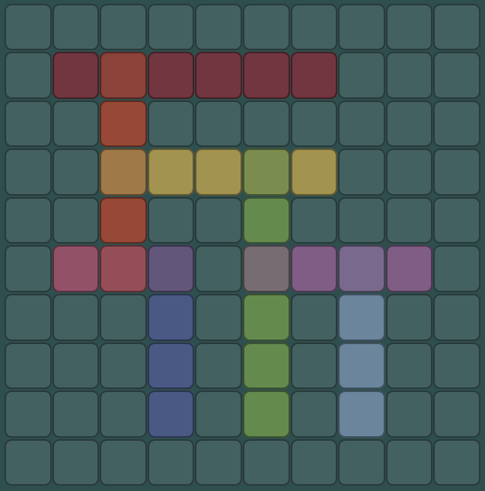
Customization
Optional features are provided to enhance the user experience.

Slide 9
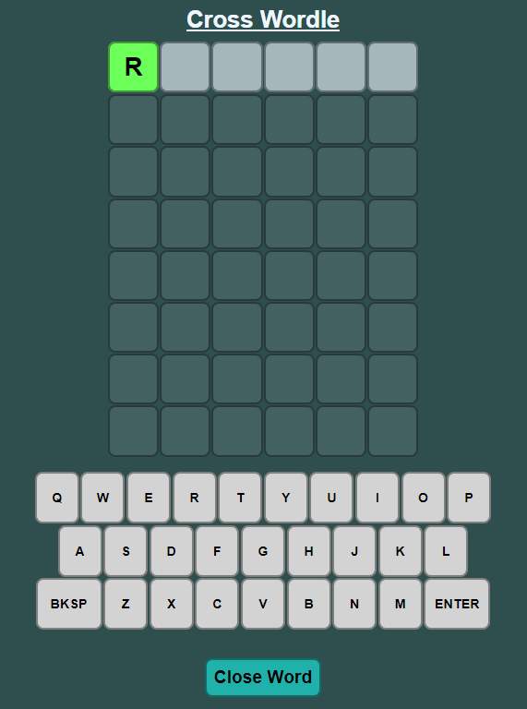
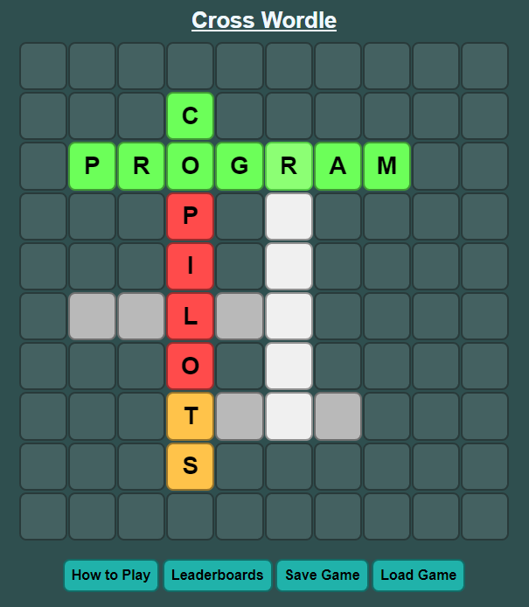
Selecting a Word
Hover and click on desired word.
Wordle-like panel for each word.

Slide 10
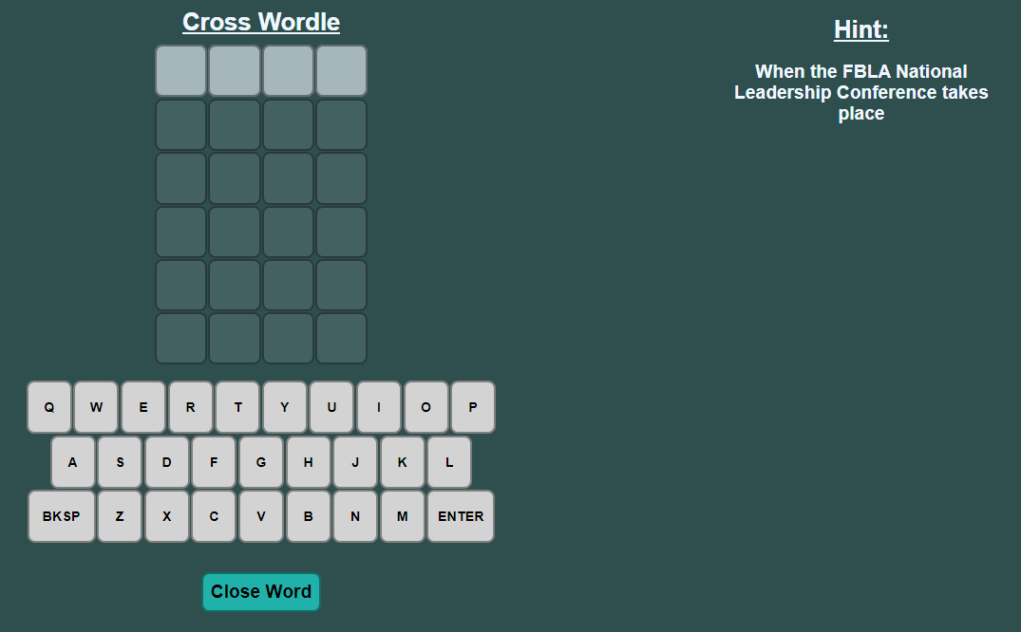
Brainstorming
Length is 4
Rows of blank spaces show the number of guesses.
Columns show word length.
A hint is provided at the top right.

Slide 11
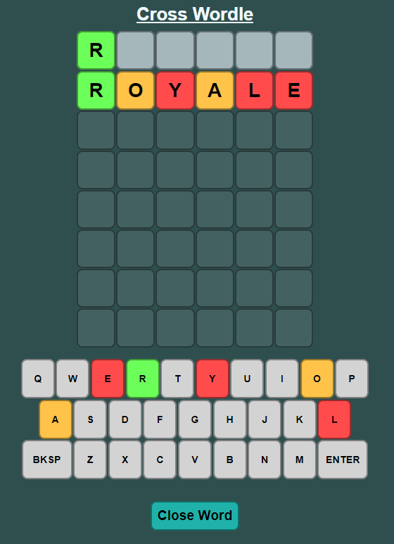
Making a Guess
The player may type using their physical keyboard, or the on-screen keyboard to enter letters.
Guess will be spellchecked and submitted as an attempt.
Green letters are correct, orange letters are in the incorrect place, and red letters are incorrect.
The player does not have to remember what they have already found.

Slide 12
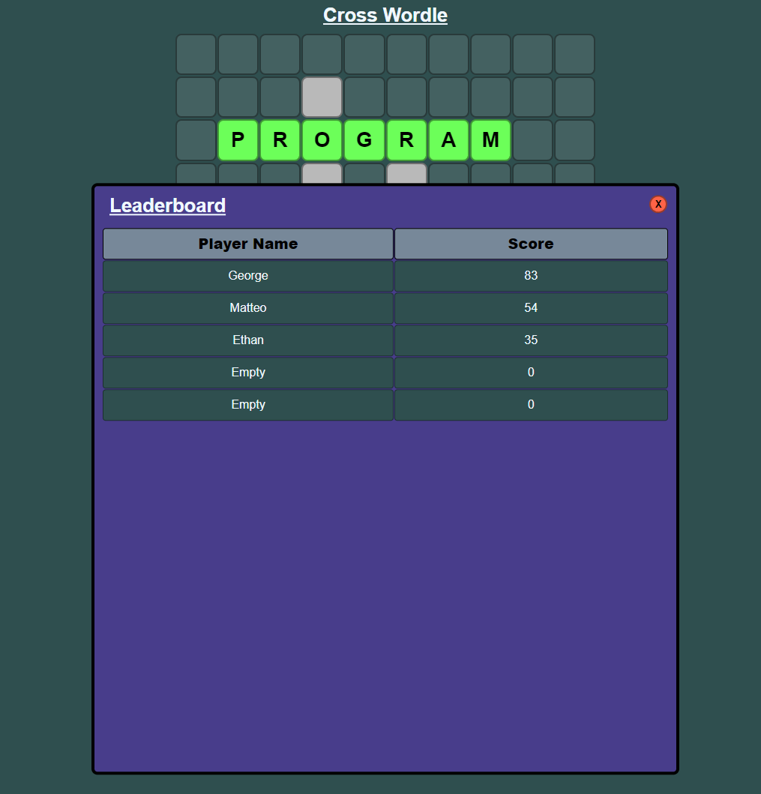
Finishing the Game
Score is calculated as follows:
Green Letters: 5 points
Orange Letters: 1 point
Red Letters: 0 points
If the player is within the top five players based on their score earned, they will be displayed on the leaderboard.

Slide 13
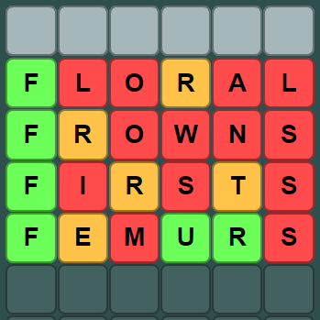
Letter Correctness Detection
Letters are checked for their correctness relative to the word.
I will now explain how this process works and the code behind it.

Slide 14
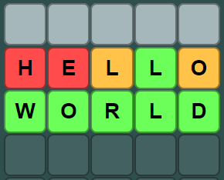
First Attempt

Slide 15
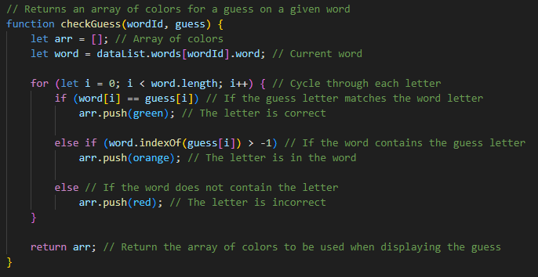
Original Code

Slide 16
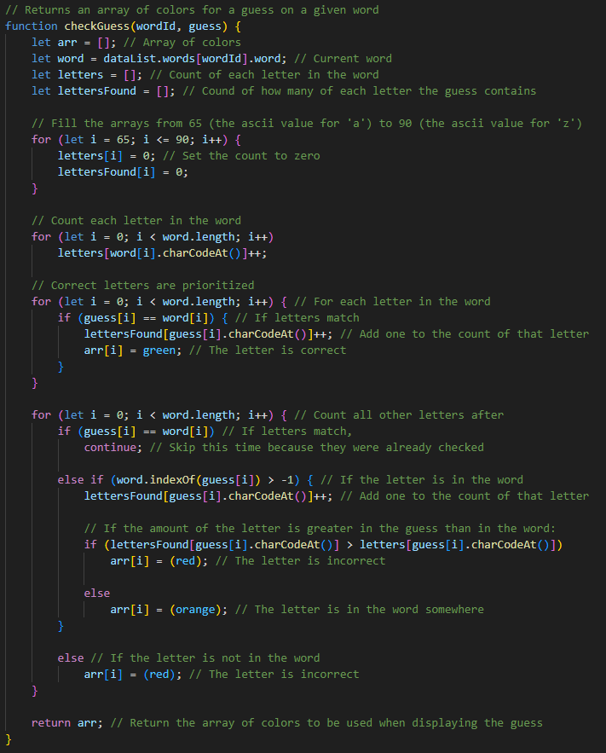
Final Code

Slide 17
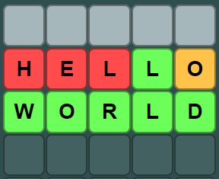
Final Product

Slide 18
Art style
Simplistic, yet colorful design.
Neutral background color makes the letter spaces really stand out.
Simple design allows for better focus.

Slide 19
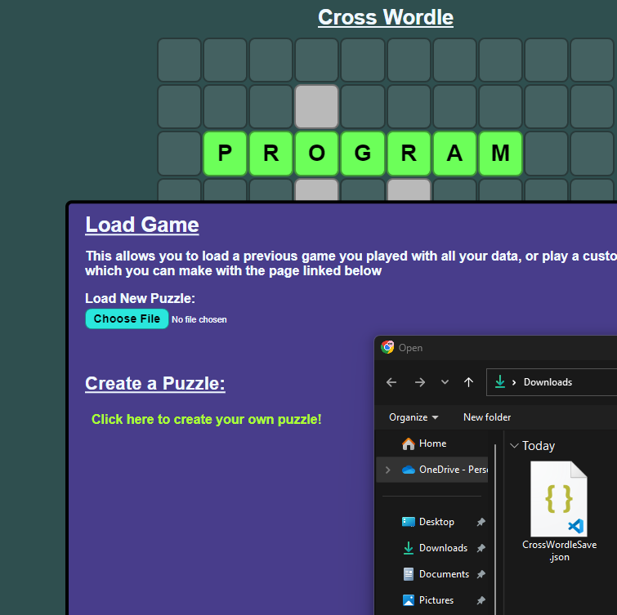
Saving/Loading Game
You can also save your game state as a file, so that you can leave and return to play later.
This feature also allows you to load custom puzzles, which can be created using the feature I will show next.

Slide 20
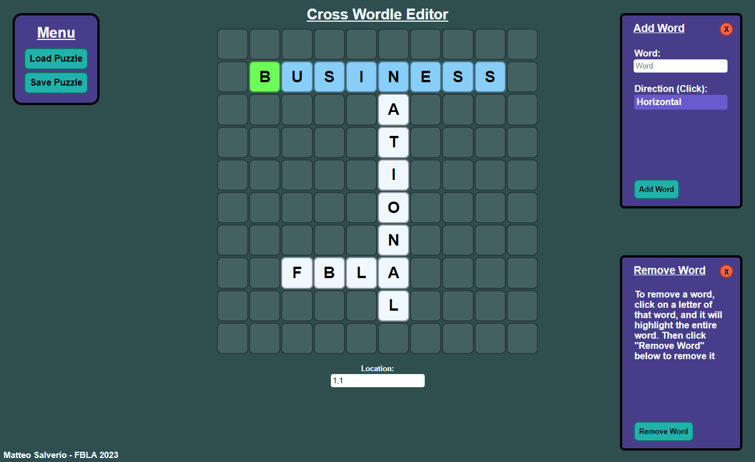
Creating Custom Puzzles
Using a tool that I created alongside the game; you can create your own puzzles for others to try out.
You can also edit existing puzzles, to make your ideal puzzle.

Slide 21
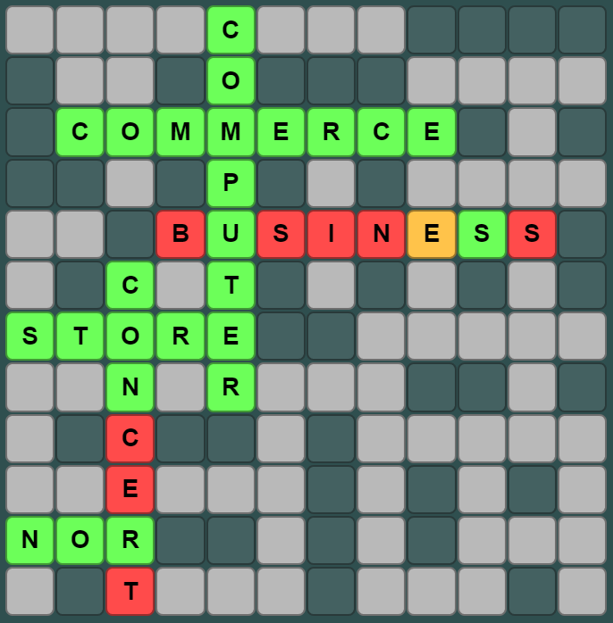
Custom Puzzles Create Scalability
Near limitless puzzle possibilities.
You can create truly challenging puzzles with little effort.

Slide 22
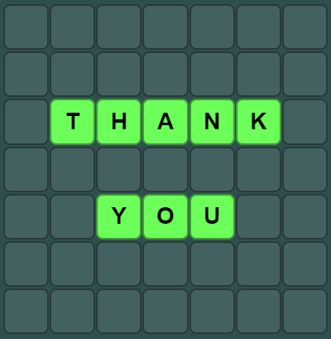
Thank You

